Slide 1
Home Learning Zoom Guide

Slide 2
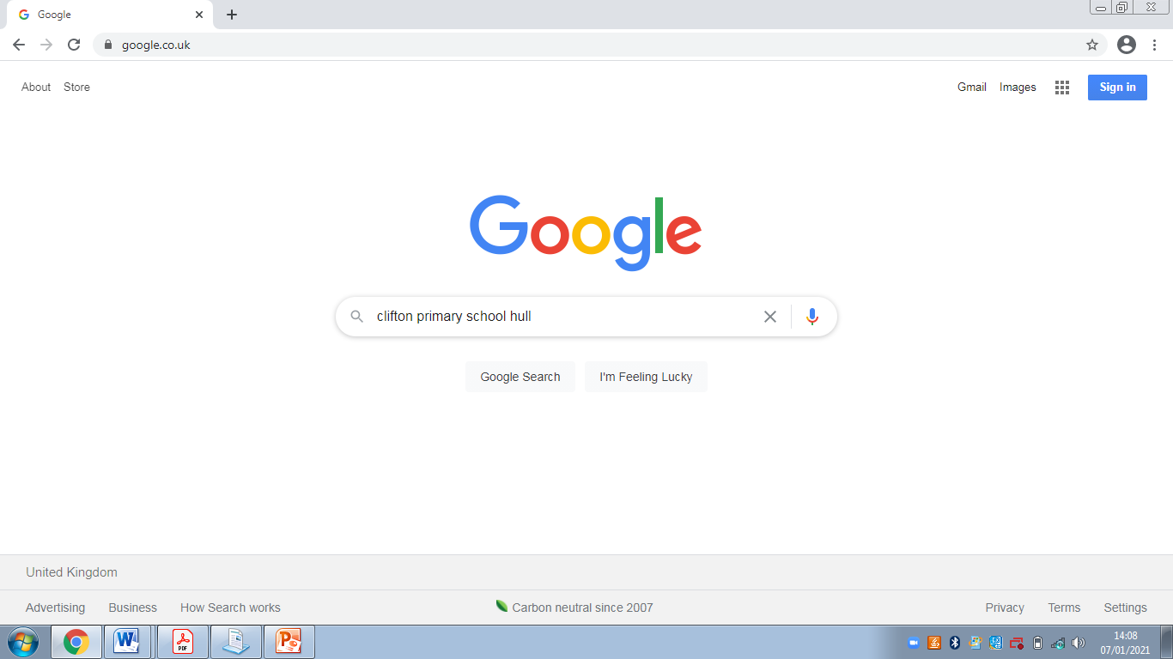
Step 1:
Type into Google Clifton Primary School Hull.

Slide 3
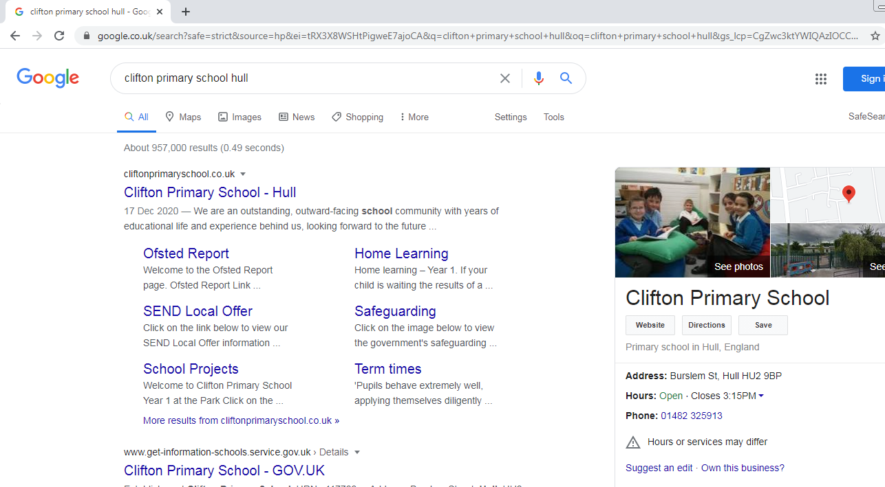
Step 2:
Click on the top search result.

Slide 4
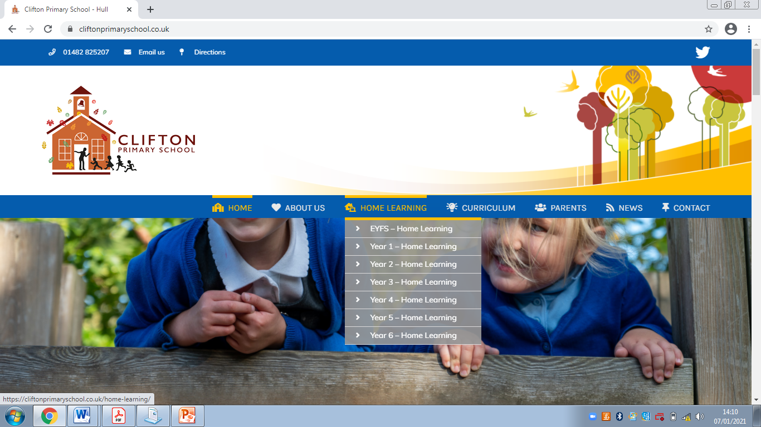
Step 3:
Go to the ‘Home Learning’ tab and click your child’s year group.

Slide 5
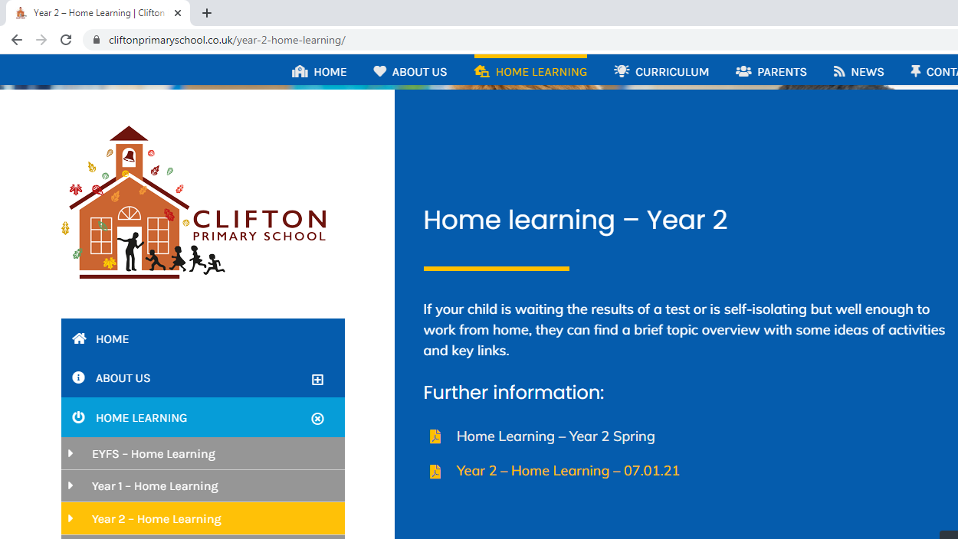
Step 4:
Click on the most recent link which will appear at the bottom of the list.
It will have a date e.g. 07.01.21.

Slide 6
Step 5:
Click the Live Link.

Slide 7
Step 5a:
If you are asked for a passcode for zoom it is here on the sheet.

Slide 8
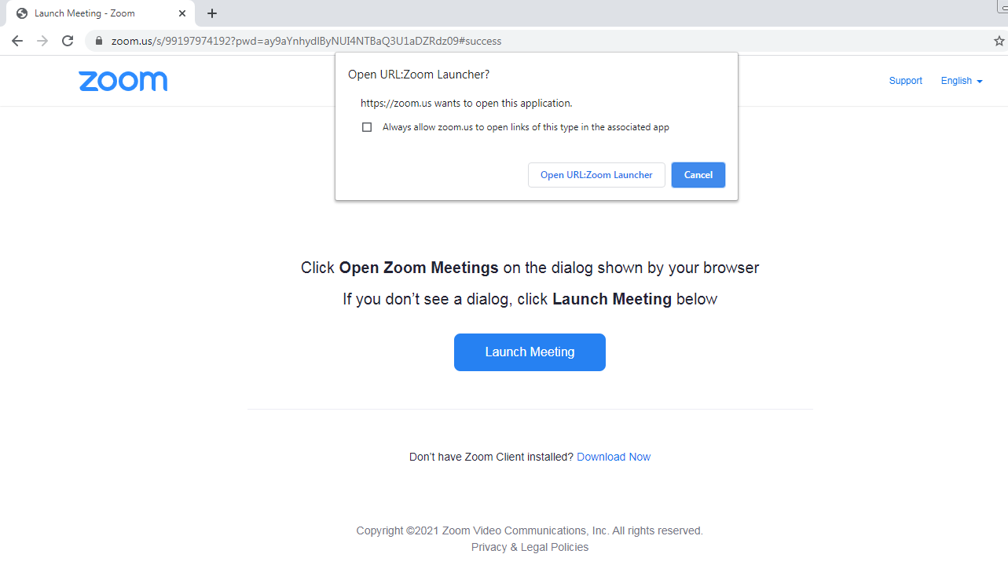
Step 6:
Click Open URL: Zoom Launcher.

Slide 9
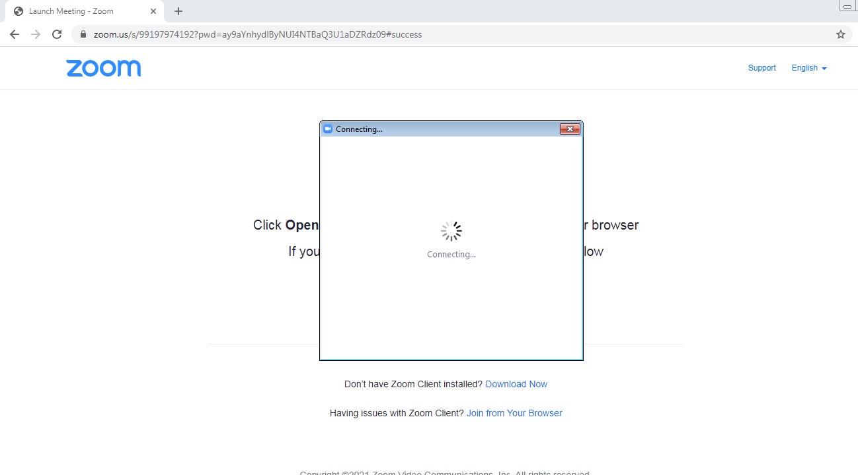
Step 7:
Zoom will start connecting.

Slide 10
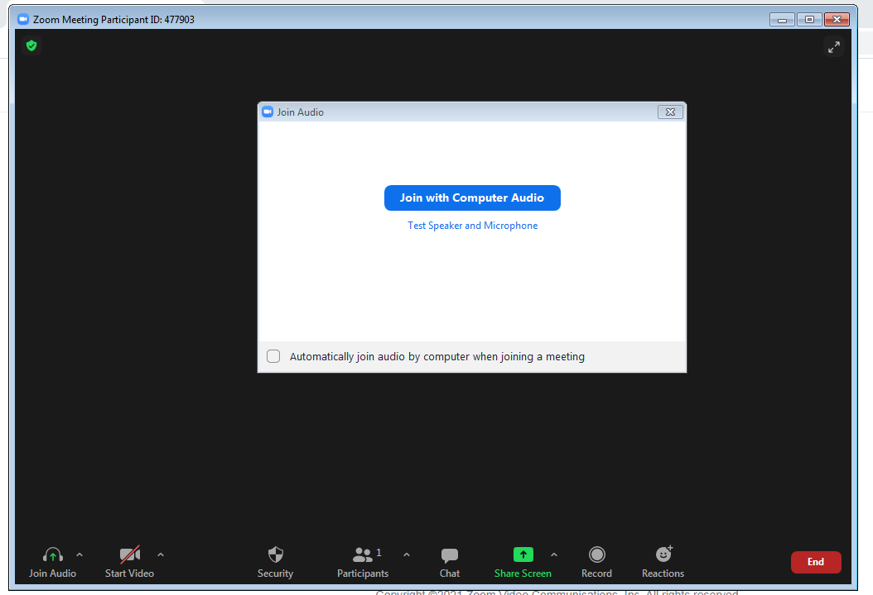
Step 8:
Click Join with Computer Audio.

Slide 11
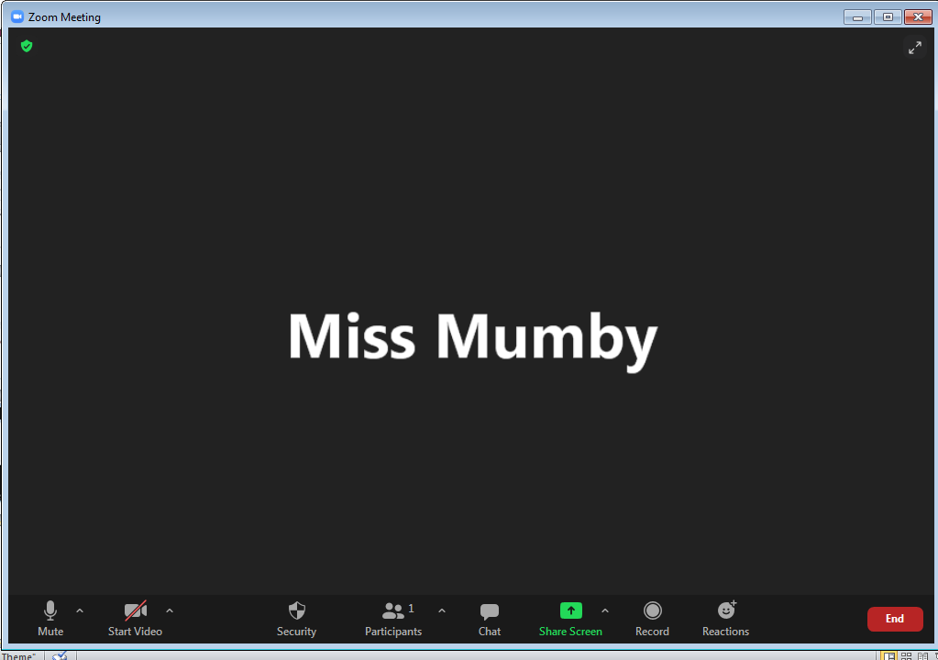
Step 9:
Click Start Video.

